Slide 1
API Management through Apigee
Deborah Barndt
Henry Post
Notes:
This presentation is why APIs should be managed and how Apigee can help you do that.

Slide 2
1.
What’s an API?
What is it exactly?

Slide 3
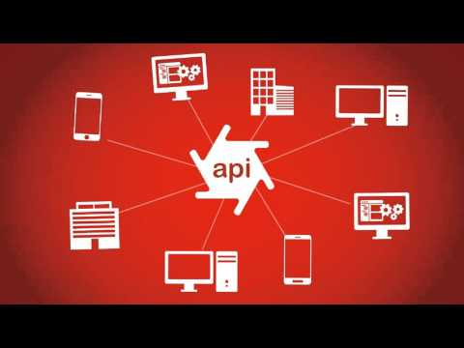
Place your screenshot here
Notes:
Application Programming Interface (API)
Allows applications to communicate with one another
Not a database
It is an access point to an app that can access a database

Slide 4
2.
Why manage APIs?
Why is this important?

Slide 5
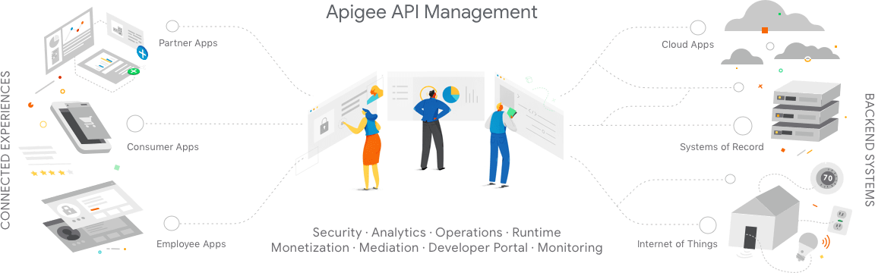
Allows you to design, secure, analyze, and scale APIs anywhere with visibility and control

Slide 6

Manage Complexity
APIs are the endpoints for information processing, retrieval, and for public consumption of a service
Can be small and simple or massive and have hundreds of endpoints
Can span across frameworks, libraries, programming languages, computers, and sometimes countries
Notes:
APIs are the endpoints for information processing, retrieval, and potentially for public consumption of a service. They can be small and simple, with perhaps one or two endpoints and ways to use, or massive and have hundreds of endpoints and tens of thousands of individual moving parts.
APIs can span across frameworks, libraries, programming languages, computers, and sometimes countries. The security and validity of any one API has the potential to affect all that consume it. If a dependency runs deep enough, the failure of one API could bring down any which rely upon it, depending on the nature of the failure.

Slide 7
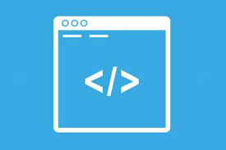
Well-designed Code
Having well documented and a clean programming interface ensures that APIs are not only easy to use but also more secure and bug-free
If the endpoints are poorly documented, it makes the API harder to use, modify, or debug
Create a standardized contract for your software called “Design-by-contract” methodology
Great way to layout how you want your software to function
Ensures your code is modular
Code is documented
Your goals are clear
Notes:
Because APIs are so complex and often gather data from disparate sources, having a well-documented and clean programming interface ensures that APIs are not only easy to use but also more secure and bug-free. If the endpoints of an API are poorly documented, it makes it harder to use, modify, or debug.
In fact, first creating a standardized ‘contract’ for your software is a great way to lay out how you want your software to function before you begin programming, to ensure your code is modular, documented, and your goals are clear. This is called ‘design-by-contract’ and is a popular software correctness methodology.

Slide 8
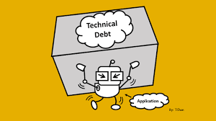
Reduce or Prevent Tech Debt
Technological Debt refers to the sum of existing problems in a company’s codebase
Managing your APIs properly can make it easier to never create tech debt
High-levels of tech debt are generally associated with slowness to change, chronic bugs, inefficiency, and have the potential to completely prevent a company from ever refactoring their code to reduce tech debt
Notes:
If a piece of software is undocumented, poorly written, or otherwise unnecessarily complex, this can make a lot of things harder when you want to create new software or modify existing software. This is generally called “technological debt”, and refers to the sum of existing problems in a company’s codebase. Managing your software (APIs) properly can make it easier to never create some of this tech debt in the first place.
High levels of tech debt are generally associated with slowness to change, chronic bugs, inefficiency, and have the potential to completely prevent a company from ever refactoring their code to reduce tech debt.

Slide 9
3.
What’s to manage?
API Endpoints

Slide 10

Security
Endpoints are the most exploitable parts of the API
Security issues that plague APIs and other web applications
Injection of any kind
Authentication exploits
Cache exploits
Cross-Site Request Forgery (CSRF)
Management and proper documentation does not eliminate these issues, but it can help shed light on security measures or problems with an APIs parameters
Notes:
Because API endpoints (hxxp://www.weatherapi.com?city=chicago&day=today) are the points of contact for other applications and potentially human beings to interact with, they are often the most exploitable parts of the API, as they are outward-facing. Things like injection of any kind, authentication exploits, cache exploits, and CSRF are all security issues that plague APIs and other web applications.
Management and proper documentation of API parameters and security requirements does not eliminate these issues, but it can help shed light on lax security measures or glaring problems with an API’s parameters.

Slide 11
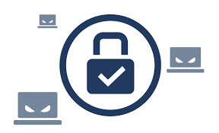
Security Example
hxxp://www.weatherapi.com?city=chicago&day=today
Consider the URL parameter of `city` with the argument of `chicago` in the above URL
Suppose this input was directly concatenated into an SQL statement: return dbMgr.exec(`SELECT * FROM weatherdb WHERE city = '${body['city']}'`);
This is an example of an SQL-injectable piece of software and can be prevented by:
Automated testing
Input fuzzing
Code reviews
Developer training
Notes:
(hxxp://www.weatherapi.com?city=chicago&day=today)
An example: Consider the URL parameter of `city` with the argument of `chicago` in the above URL.
Suppose this input was directly concatenated into an SQL statement like so:
return dbMgr.exec(`SELECT * FROM weatherdb WHERE city = '${body['city']}'`);
This is a prime example of an SQL-injectable piece of software. As for how to prevent this: A combination of automated testing, fuzzing, code reviews, and developer training will help prevent vulnerabilities from being created.
This is mock Javascript with ECMAscript 6 string interpolation, hence the backticks.

Slide 12
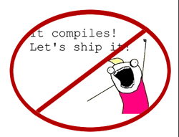
Correctness
Eliminating bugs and flaws in software can be done through good coding practices
The previous vulnerability could have been detected by developer training, unit tests, or input sanitization
Unit tests are a great way to ensure that software doesn’t break under pressure or at edge cases
Correctness tests are a good way to prove that an algorithm can successfully complete a task
Notes:
As you saw with the previous piece of mock javascript, it can be very easy to introduce vulnerabilities into a codebase. Eliminating bugs and flaws in software can be done through good coding practices, but humans are not perfect.
The previous vulnerability could have been eliminated, mitigated, or detected in a couple ways: developer training, fuzzing tests, or input sanitization.
Automated testing like unit tests or fuzzing tests are a great way to ensure that software doesn’t break under pressure or at edge cases. Correctness tests are also a good way to prove (sometimes mathematically) that an algorithm can successfully complete some task.

Slide 13
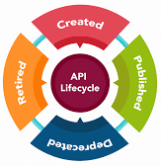
API Lifecycle
From concept to initial development, testing, deployment, and decommissioning; an API will have to be managed throughout that process
Things to consider when developing an API:
Documentation
Issue tracking
Feature implementations
Security
Actual development
Notes:
Just like any other software, an API has a lifecycle. From concept to initial development, testing, deployment, and decommissioning, an API will have to be managed by some entity throughout that process.
Documentation, issue tracking, feature implementations, security, and actual development are all things that need to be taken into consideration when developing an API.

Slide 14
4.
What does Apigee do?
How can it help manage your APIs?

Slide 15
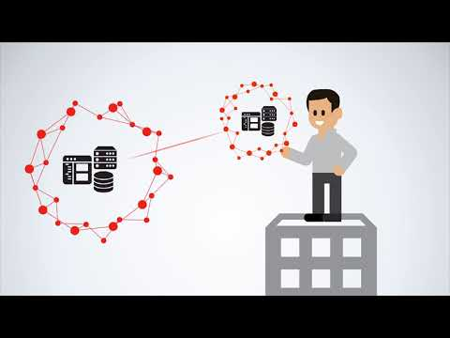
Place your screenshot here
Notes:
Video about how Apigee will help you in this cross-cloud world

Slide 16
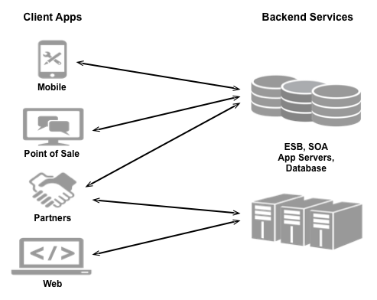
Making your services available on the web
Companies want to make their backend services available on the web so that these services can be consumed by apps running on mobile devices and desktops.
Notes:
Companies want to make their backend services available on the web so that these services can be consumed by apps running on mobile devices and desktops. These apps might be developed and released by the same company that exposed the services, or by third-party app developers who make use of publicly available services. This image shows what this type of model looks like.

Slide 17
Making your services available on the web
Because providers make their services available over the web, they must ensure that they have taken all necessary steps to secure and protect their services from unauthorized access
As a service provider you want to consider:
Security: How will you control access to your services to prevent unauthorized access?
Compatibility: Will your services work across different platforms and devices?
Measurability: How can you monitor your services to make sure they are available?
Monetization: How can you track and bill customers for access to your services?

Slide 18
Service Providers
Are required to make sure that those services continue to work over time as they add, modify, or delete those services
Must also have a way to keep the app developers aware of any changes to the services to ensure that the client apps stay in sync with those services
Client app developers can face challenges when trying to consume services from different providers
The same client app might have to use one mechanism to consume a service from one provider, and a different mechanism to consumer a service from another provider

Slide 19
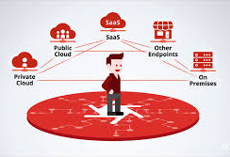
Make services available through Apigee
Apigee is built on Java
Enables you to provide secure access to your services with a well-defined API
A consistent API
Makes it easy for app developers to consume your services
Enables you to change the backend service implementation without affecting the public API
Enables you to take advantage of the analytics, monetization, developer portal, and other features

Slide 20
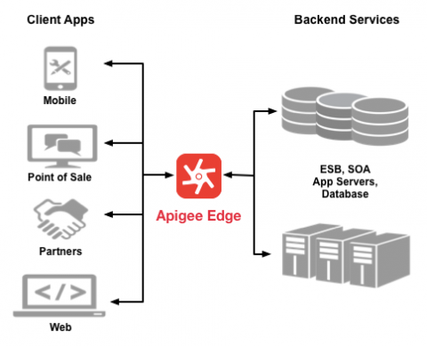
Architecture with Apigee
This image shows an architecture with Apigee handling the requests from client apps to your backend services.

Slide 21
Make services available through Apigee
Instead of having app developers consume their services directly, they can access an API proxy created on Apigee
API proxy functions as a mapping of a publicly available HTTP endpoint to your backend service
Apigee handles the security and authorization tasks required to protect your services, as well as analyze, monitor, and monetize those services
All the developer needs to know is:
The URL of the API proxy endpoint
Any query parameters, headers, or body parameters passed in a request
Any required authentication and authorization credentials
The format of the response, including response data format
Notes:
The API proxy isolates the app developer from your backend service, which makes you free to change the service implementation as long as the public API remains consistent. The proxy can also be used to add functionality to a service without having to make any changes to the backend service.

Slide 22
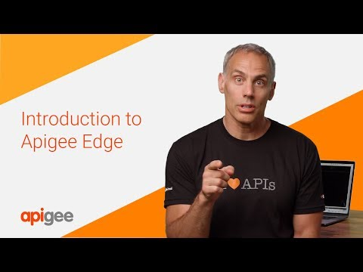
Place your screenshot here
Notes:
Let’s watch a short video on how Apigee can help you manage your APIs

Slide 23
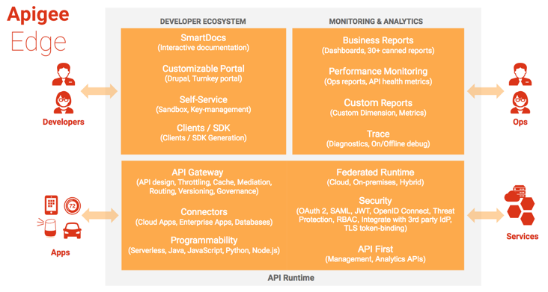
Components of Apigee
Notes:
Apigee consists of API runtime, monitoring and analytics, and developer services that together provide a comprehensive infrastructure for API creation, security, management, and operations.
The API management server provides tools for adding and configuring your API proxies, setting up API products, and managing app developers and client apps. It offloads many management concerns from your backend services. When you add an API proxy, you can apply policies to it for adding security, rate-limiting, mediation, caching, and so on. The behavior of the proxy can also be customized by applying custom scripts, making calls out to third-party APIs and services, and so on.

Slide 24
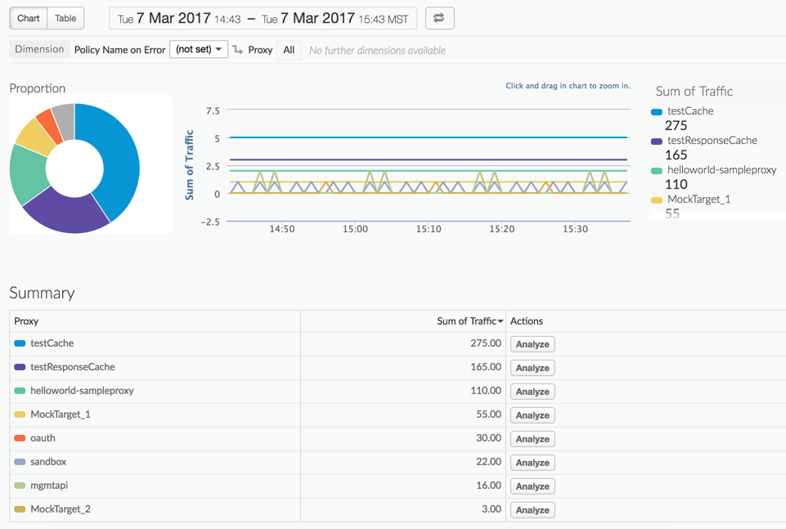
Apigee Monitoring & Analytics
Notes:
The analytics services of Apigee provides powerful tools to see the short and long term usage trends of your APIs. You can segment your audience by top developers and apps, understand usage by API method to know where to invest, and create custom reports on business or operational level information. As data passes through, several default types of information are collected including URL, IP, user ID for API call information, latency, error data, and so on. It also allows you to create policies to add other information, such as headers, query parameters, and portions of a request or response extracted from XML or JSON and it’s all collected asynchronously. The management UI lets you view multiple metrics and dimensions in a browser as seen here.

Slide 25
Edge Developer Ecosystem
Apigee provides developer services that enable you to:
Manage the community of app developers that are using your services
Work with internal and external developers and formalize the relationships with financial models
Onboard developers and create a developer portal
App developers connect to your portal to access API documentation to learn more about your publicly available API products and manage API keys
The custom portal that you create can be made either in the cloud or on-premises with Apigee for Private Cloud

Slide 26
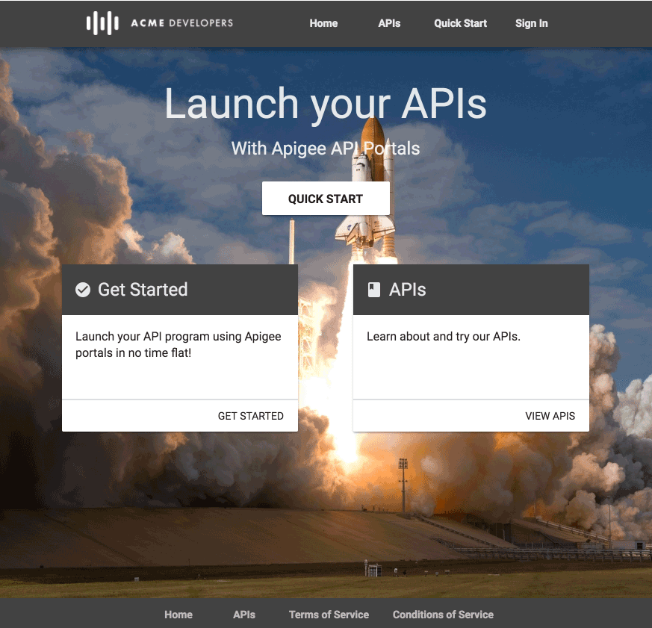
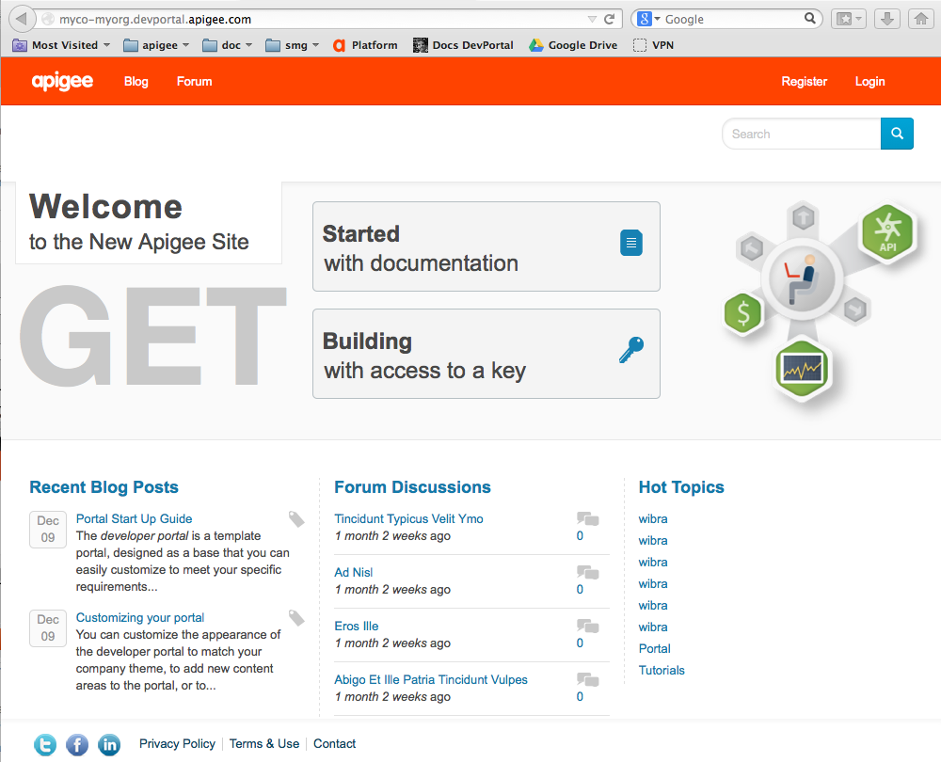
Types of Portals through Apigee
Integrated portal
Drupal-based portal
Notes:
The integrated portal can be instantly provisioned to document and manage access to your APIs, and foster your API developer community.
The drupal-based portal provides a rich set of functionality and all the CMS capabilities of Drupal with additional Apigee-developed Drupal modules.

Slide 27
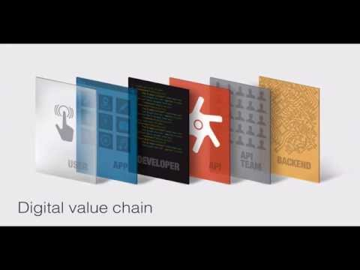
Place your screenshot here
Notes:
Now let’s watch a short demo of Apigee

Slide 28
Thanks!
Any questions?

